Slide 1
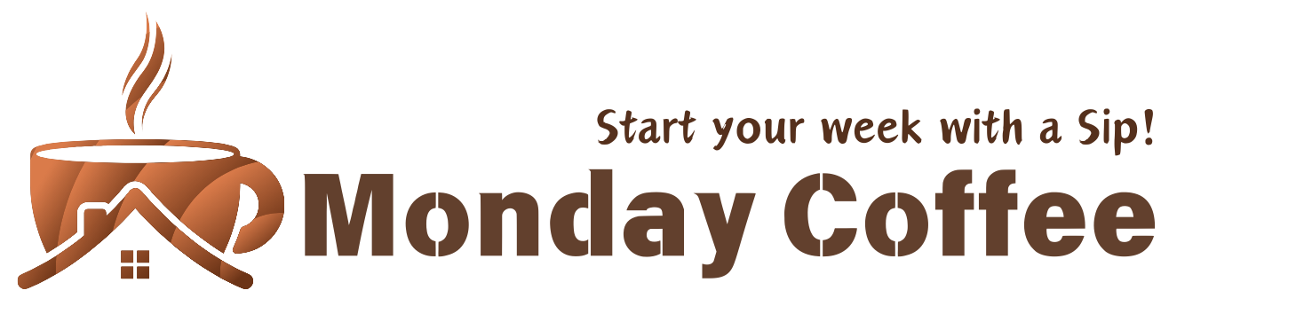
Expansion Analysis
By:- Archie Patel

Slide 2
Objective
The business aims to expand by opening three coffee shops in India’s top three major cities. Since its launch in January 2023, the company has successfully sold its products online and received an overwhelmingly positive response in several cities. As a data analyst, the task is to analyze the sales data and provide insights to recommend the top three cities for this expansion.

Slide 3
Data Overview
4 Tables in Dataset:
sales :- Includes columns such as sale_id, sale_date, product_id, customer_id, total (sales), rating. The total rows in this table are 10388.
city :- Includes columns such as city_id, city_name, population, estimated_rent, city_rank. The total rows in this table are 13
customers :- Includes columns such as customer_id, customer_name, city_id. The total rows in this table are 497.
Products :- Includes columns such as product_id, product_name, price. The total rows ain this table are 28.

Slide 4
Key concepts used
SELECT
WHERE
ORDERBY
JOINS
GROUPBY
AGGREGATE
SUBQUERIES

Slide 5
Insights
Coffee Consumers Count
If 25% of the population consumes coffee, the count of coffee consumers is 34.99 million.
Total Revenue from Coffee Sales
In the last quarter of 2023, the total revenue in all the cities is 1963300.
Average Sales Amount per City
This metric represents the mean revenue generated per city, providing insights into regional performance and potential growth areas.

Slide 6
Top Selling Products by City
This insight highlights the highest-selling products within each city, helping identify local preferences and tailor city-specific marketing or inventory strategies.
Average Sale vs Rent
Compares the average revenue generated per store against its average rent, offering a profitability snapshot by city or region.
Monthly Sales Growth
Analyzes how total sales fluctuate month-over-month, identifying peak performance periods and potential seasonal trends.

Slide 7
Recommendations
City 1: Pune
Average rent per customer is very low.
Highest total revenue.
Average sales per customer is also high.
City 2: Delhi
Highest estimated coffee consumers at 7.7 million.
Highest total number of customers, which is 68.
Average rent per customer is 330 (still under 500).

Slide 8
City 3: Jaipur
Highest number of customers, which is 69.
Average rent per customer is very low at 156.
Average sales per customer is better at 11.6k.

